Slide 1
MyStatway™ – Online Resources
Course readings & guided notes which supplement Statway™ lessons
Checkpoints which quiz students at the end of each topic and the end of each module
Interactive mini assessments embedded in guided notes
CDF animations
Data collection tool for continuous improvement (Faculty & Student Surveys)

Slide 2
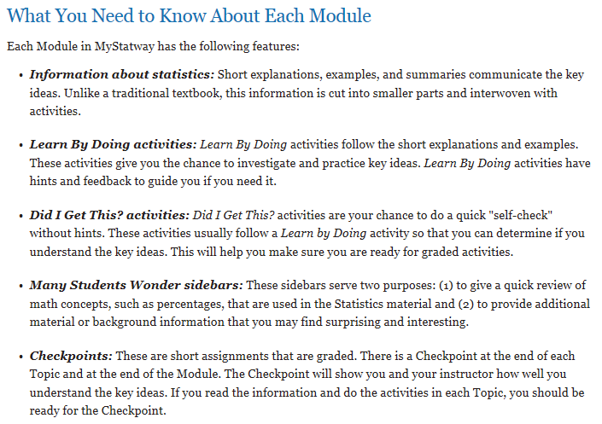

Slide 3
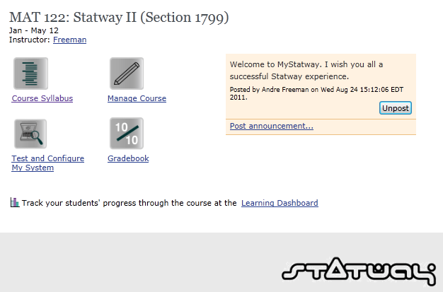

Slide 4
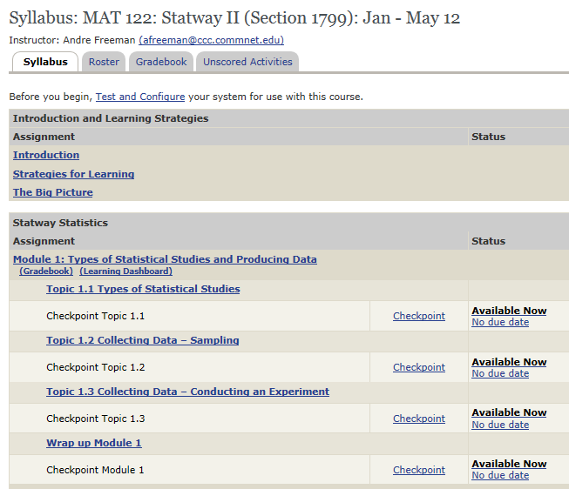

Slide 5
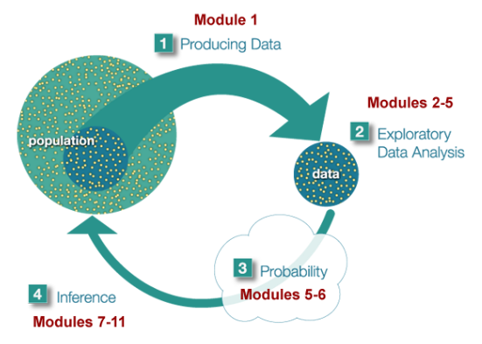
MyStatway™ is organized around the
Big Picture of Statistics.

Slide 6
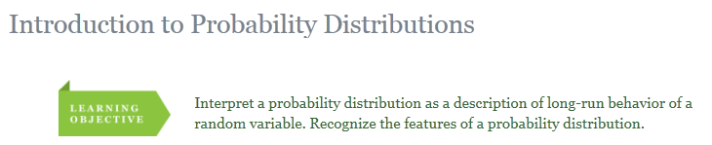
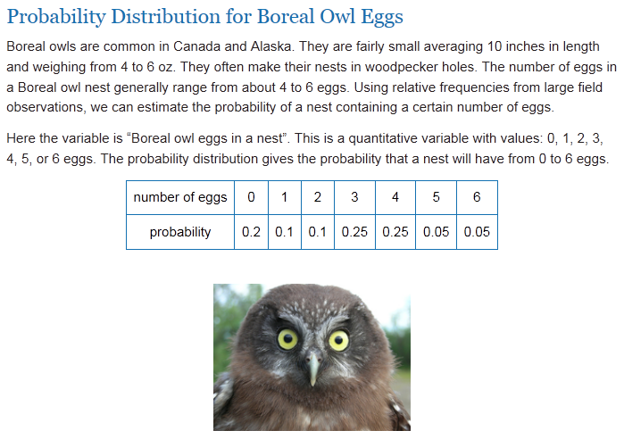

Slide 7
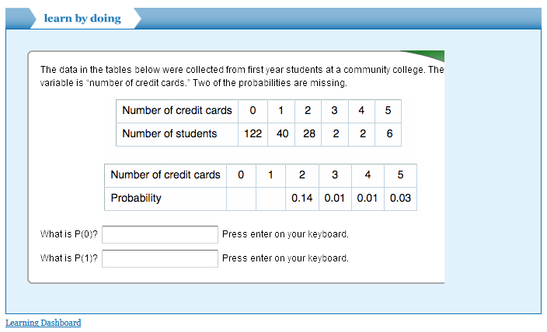

Slide 8
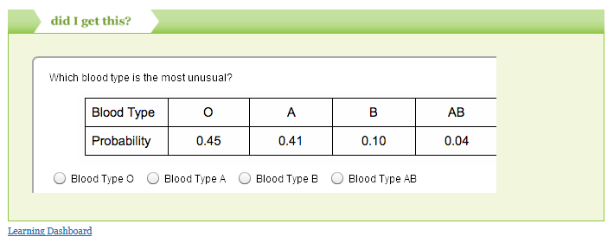
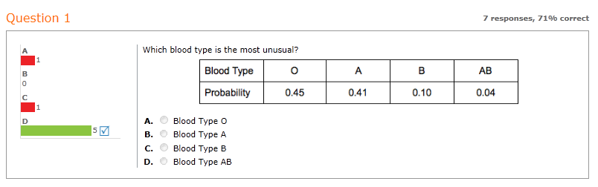

Slide 9
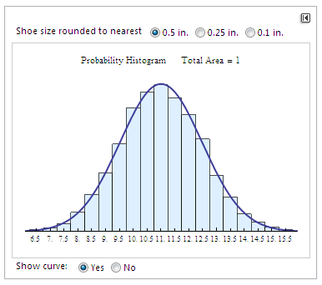

Slide 10
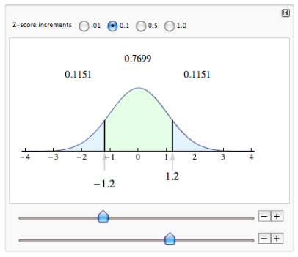

Slide 11
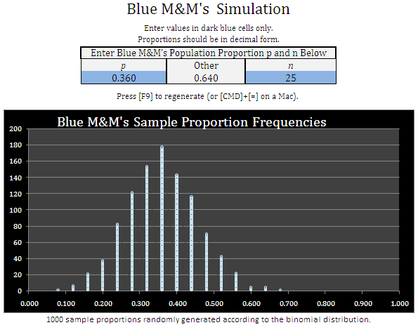

Slide 12
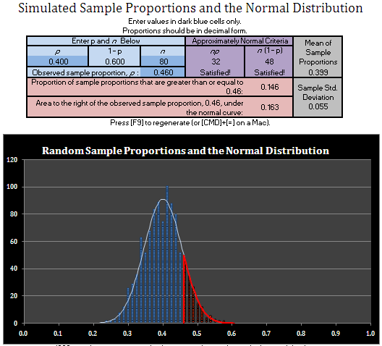
Notes:
Roberta… you pick what you want to use on 11 – 15 (you are the productive persistence queen!)
Also… the results… 16 and 17 (anything different you’d like to share?)
Slide 18… add the lesson and if you want to tie up the lesson… add a slide

Slide 13
